Slide 1
SCHOOL DISTRICT BUDGETS:
NOW WHAT?
COVID-19 and School Finance

Slide 2
Instructions:
Use telephone – select “Telephone” in the Audio panel and the dial-in information will be displayed.
Submit questions – type your questions into the “Questions” section of the control panel. You may send in your questions at any time during the this webinar.

Slide 3
Instructions:
Handouts - powerpoint presentation, Jason Hoffman’s expenditure chart and Prop C History can be downloaded

Slide 4
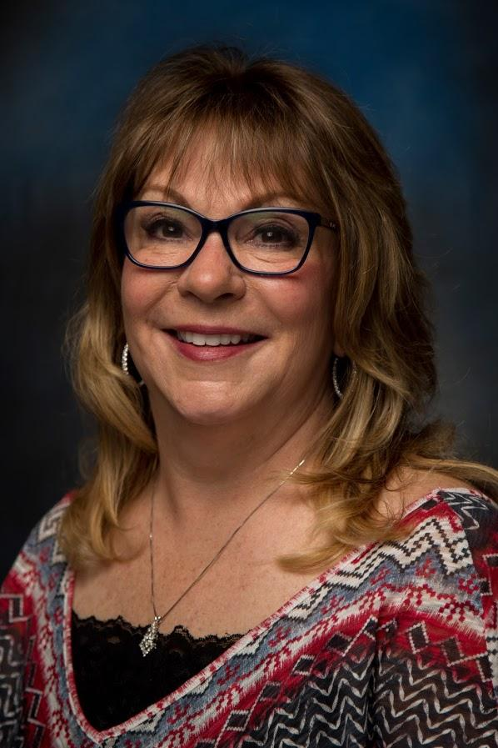
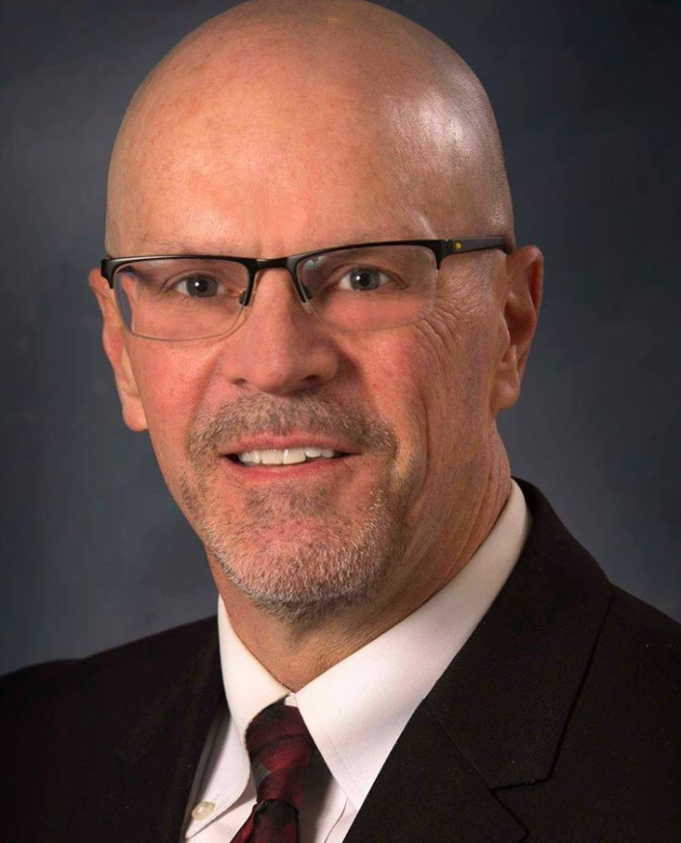
Kim Cranston, MoASBO
Exec. Director
Dr. Doug Hayter,
MASA
Exec. Director

Slide 5
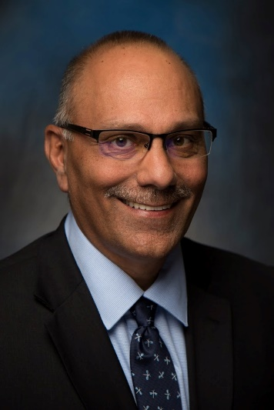
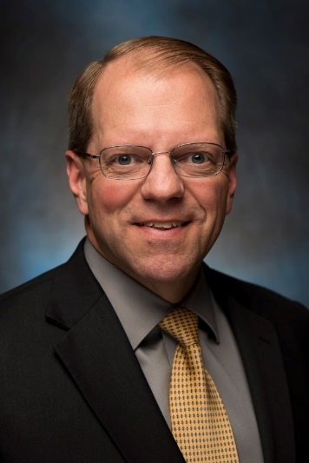
Panelists:
Dr. Jim Cummins
Dr. Kari Monsees
Jason Hoffman
Ron Orr

Slide 6
OVERVIEW
Short-term impacts on revenues/expenditures
FY20 impact on Prop C
FY20 impact on Foundation and Transportation formulas
CARES Act impact: Education Stabilization Fund
CARES Act impact: Coronavirus Relief Fund
FY21 forecast: state funds & Prop C
FY21 forecast: property taxes
Q&A
Notes:
Jim

Slide 7
Energy savings - unoccupied buildings
Substitute costs
Waste management, recycling and composting
Decreased food service supplies and food
Instructional and office supplies
Overtime
Travel and professional development
Homeless transportation
Fuel
Self funded health and dental - expect lower utilization and fewer surgeries etc. Unless COVID spikes and we have lots of hospitalizations.
Worker’s Compensation - possibly reduced instances and lower MOD since employees aren’t working.
Possibly summer school - may be significant savings for some districts, but a significant loss of revenue for others.
Cost Savings Measures
With buildings shut down there is the opportunity to capture savings and offset lost revenue and extraordinary expenses during this time.
Notes:
Jim

Slide 8
Community Education revenue
Early childhood Tuition
Facility Rental Income
Interest earnings, but MOSIP may be a good short term solution
Future local revenue if 2021 reassessment is impacted
Collection rates for property taxes
Delayed income tax filing and decreased state revenues impact on the foundation formula
Prop C Sales tax revenue
Reduced meal reimbursements
Paid meals
Possibly summer school
Negative impacts on revenue
The CARES Act may offset some of these loses.
Notes:
Jim

Slide 9
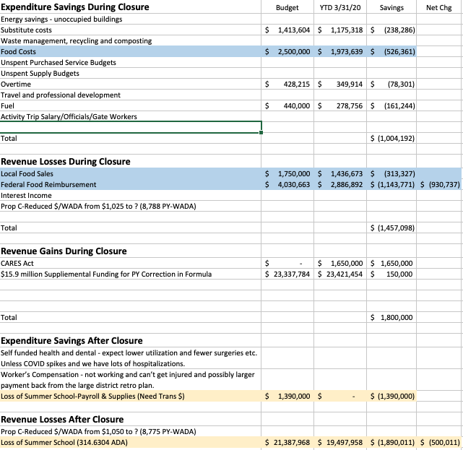
Expense Tracking
Notes:
Jason

Slide 10
FY20 Prop C Revenue
From DESE February YTD collections as a % of Appropriations
Based on original appropriations the amount paid per WADA was estimated at $1,036.
Through February collections were trending lower than prior years as a percentage of budget.
Based on historical collections through February the amount paid per WADA could be: $997 - $970. This would be a reduction of 4% - 6%.
March collections were 5.9% higher than the previous year, and likely fueled by stockpiling.
However, future collections are uncertain and may possibly worsen. Between FY07 and FY10 payment per WADA dropped 10%.
Notes:
Ron

Slide 11
FY20 Formula/Transportation Revenue
No withholdings to date for PK-12.
Budget office has indicated the combination of recently announced withholds and anticipated federal relief funds could bridge the gap for this fiscal year.
Supplemental (HB 2014) includes additional formula funds to cover prior year correction.
Word of caution: K-12 is one of the few remaining areas with available GR funds to withhold if needed.
Transportation has traditionally been a target of withholdings.
Notes:
Ron

Slide 12
CARES Act Impact: Education Stabilization Fund
Elementary & Secondary School Emergency Relief Fund: $13.5 billion to states to support K-12 education ($208 million for MO).
Title I distribution formula to be utilized.
Estimated at 82% of district’s current Title I allocation (timing TBD).
Use of funds (awaiting detailed guidance) - list of 12 specified uses includes:
(12) Other activities that are necessary to maintain the
operation of and continuity of services in local educational
agencies and continuing to employ existing staff of the local
educational agency.
Notes:
Kari

Slide 13
CARES Act Impact: Education Stabilization Fund
Governor’s Emergency Education Relief Fund: $3 billion total ($54 million for MO).
Distributed to K-12 and/or Higher Education at Governor’s discretion.
Supplemental budget gives Governor spending authority in K-12.
Use of funds (awaiting detailed guidance) - see April 9 DESE memo.
U.S. Dept of Education has 30 days to issue applications to states, and must respond to state applications within 30 days of receipt.
Notes:
Kari

Slide 14
CARES Act Impact: Education Stabilization Fund
CONTINUED PAYMENT TO EMPLOYEES
SEC. 18006. A local educational agency, State, institution of
higher education, or other entity that receives funds under ‘‘Education
Stabilization Fund’’, shall to the greatest extent practicable,
continue to pay its employees and contractors during the period
of any disruptions or closures related to coronavirus.
Notes:
Kari

Slide 15
CARES Act Impact: Coronavirus Relief Fund
Coronavirus Relief Fund: Missouri estimated to receive $2.38 billion to support state and local governments - distribution uncertain at this time.
USE OF FUNDS.—A State, Tribal government, and unit of local government shall use the funds provided under a payment made under this section to cover only those costs of the State, Tribal government, or unit of local government that— ‘‘(1) are necessary expenditures incurred due to the public health emergency with respect to the Coronavirus Disease 2019 (COVID–19); ‘‘(2) were not accounted for in the budget most recently approved as of the date of enactment of this section for the State or government; and ‘‘(3) were incurred during the period that begins on March 1, 2020, and ends on December 30, 2020.
Notes:
Kari

Slide 16
HB 2014: FY20 Supplemental Bill
Previously approved by the House, revised with Governor’s amendments for COVID relief and emergency spending provisions.
Includes $11.9 million for ESCE.
Includes $15.8 million for formula prior year correction (FY19).
Includes $300 million in federal authorization for CARES Act distribution.
Includes $1.5 billion in federal authorization for future stimulus/recovery bills if they were to occur before June 30 (potential to replace lost General Revenue).
Notes:
Jason

Slide 17
FY21 Forecast: State Funds & Prop C (uncharted waters)
State Budget: Not following typical timeline. Summer special session being discussed. Even when approved, revenue impact of COVID-19 will not be fully known.
Formula/SAT: Traditionally a priority of the Legislature. For every $25 million shortfall in funding, the SAT drops by approximately $33.
CTF: Actual revenues will be impacted by return date of Riverboat activities. Need to evaluate appropriation of GR versus Gaming funds in the final state budget.
Transportation: Common source of withholdings, consider level funding best case.
Prop C: Recovery funds will help maintain consumer spending, but expect a decline. Last recession resulted in a 10% drop in revenues.
Notes:
Jason

Slide 18
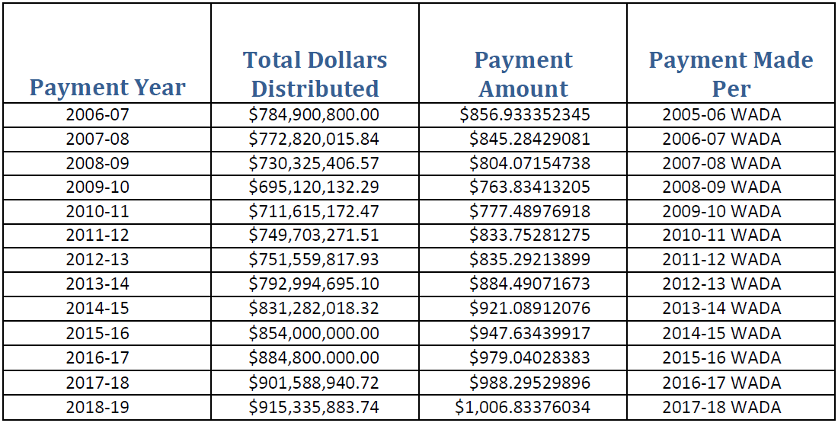
Prop C Historical
Notes:
Jason

Slide 19
FY21 Forecast: Property Tax Revenue
If impacts of current closures continue into 2021 there could be a negative impact on 2021 reassessment, which is the value of property as of January 1, 2021. This would also impact 2022.
Potential rise in appeals for 2020 tax year even though it’s not a reassessment year.
Commercial property is based off of the income producing abilities of a property, rent, and sales.
Possible lack of sales transactions on residential property.
Potential for lower collection rates than normal (compare to 2008-2010).
How much can property values decrease before a district reaches maximum tax rates?
Notes:
Ron

Slide 20
Summary
This budget development year is like no other.
Confidence will be low in any revenue forecast used by the Legislators to build the FY21 budget.
End date of social distancing will play a large part in determining the depth of revenue impacts.
Delaying decisions that can be delayed will allow for more informed decisions.
Take advantage of any efficiency savings you can while planning for next year.
Short-term use of reserves can be expected as we work through this budget cycle.
Notes:
Ron

Slide 21
Questions?

Slide 22
Provide your feedback by completing a short survey

